Slide 1
Chapter 23
Testing Conventional Applications

Slide 2
What is a “Good” Test?
A good test has a high probability of finding an error
A good test is not redundant.
A good test should be “best of breed”
A good test should be neither too simple nor too complex

Slide 3
Test Case Design
"Bugs lurk in corners
and congregate at
boundaries ..."
Boris Beizer
OBJECTIVE
to uncover errors
CRITERIA
in a complete manner
CONSTRAINT
with a minimum of effort and time

Slide 4
Exhaustive Testing
loop < 20 X
14
There are 10 possible paths! If we execute one
test per millisecond, it would take 3,170 years to
test this program!!

Slide 5
Selective Testing
Selected path
loop < 20 X

Slide 6
Software Testing
white-box
methods
black-box
methods
Methods
Strategies

Slide 7

White-Box Testing
... our goal is to ensure that all
statements and conditions have
been executed at least once ...

Slide 8
Why Cover?
logic errors and incorrect assumptions
are inversely proportional to a path's
execution probability
we often
believe
that a path is not
likely to be executed; in fact, reality is
often counter intuitive
typographical errors are random; it's
likely that untested paths will contain
some

Slide 9
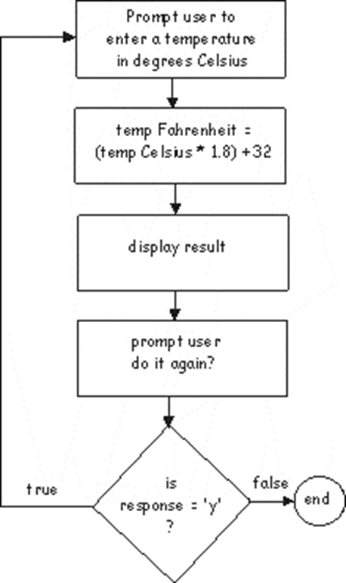
Do-while
do
{
Console. Write(“give me a temperature :”);
tempC = double.Parse(Console.ReadLine( ) );
tempF = tempC * 1.8 + 32;
Console.WriteLine(“The F temp is {0}“, tempF);
Console.Write(“Do it again? ”);
response = char.Parse(Console.ReadLine( ) );
response = char.ToLower(response);
} while(response == ‘y’);

Slide 10
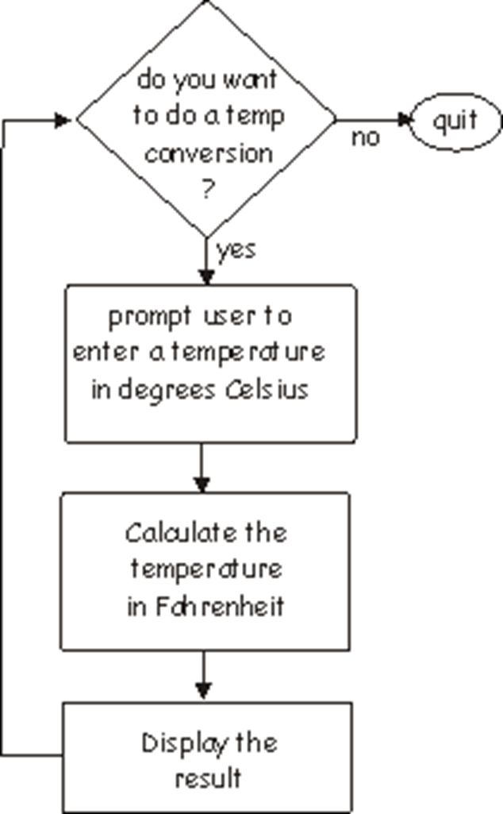

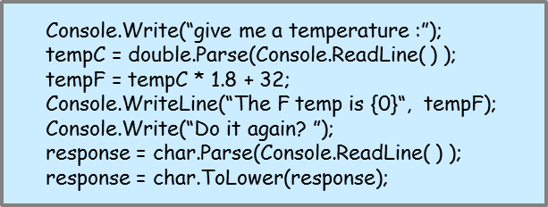
While

Slide 11
How about
while ( response == “Y” && value > 5)
{…do sth…}
while ( response == “Y” || value > 5)
{…do sth…}
Practice: bubble sort, binary search.
N
Response == “Y”
Response == “Y”
Y
Y
N
Value > 5
N
Do something
Value > 5
Y
Y
Do something
N

Slide 12
Why Cover?
logic errors and incorrect assumptions
are inversely proportional to a path's
execution probability
we often
believe
that a path is not
likely to be executed; in fact, reality is
often counter intuitive
typographical errors are random; it's
likely that untested paths will contain
some

Slide 13
Basis Path Testing
First, we compute the cyclomatic
complexity:
number of simple decisions + 1
or
number of enclosed areas + 1
In this case, V(G) = 4

Slide 14
Cyclomatic Complexity
A number of industry studies have indicated
that the higher V(G), the higher the probability
or errors.
modules
V(G)
modules in this range are
more error prone

Slide 15
Basis Path Testing
1
Next, we derive the
independent paths:
2
Since V(G) = 4,
there are four paths
3
Path 1: 1,2,3,6,7,8
4
Path 2: 1,2,3,5,7,8
5
6
Path 3: 1,2,4,7,8
Path 4: 1,2,4,7,2,4,...7,8
Finally, we derive test
7
cases to exercise these
paths.
8

Slide 16
Basis Path Testing Notes
you don't need a flow chart,
but the picture will help when
you trace program paths
count each simple logical test,
compound tests count as 2 or
more
basis path testing should be
applied to critical modules

Slide 17
Deriving Test Cases
Line Coverage
Branch Coverage
Condition Coverage

Slide 18
Example
If (a>3 && b==4)
c = a;
else
c = b;
Line coverage: (a = 4, b==4), (a = 2, any b)
Branch coverage: (a = 4, b==4), (a = 2, any b)
Condition coverage:
a = 4, b = 4
a = 4, b = 3
a = 2, b = 4
a = 2, b = 3

Slide 19
Practic
Example
If (a>3 && b==4)
c = a;

Slide 20
Black-Box Testing
requirements
output
input
events

Slide 21
Black-Box Testing
How is functional validity tested?
How is system behavior and performance tested?
What classes of input will make good test cases?
Is the system particularly sensitive to certain input values?
How are the boundaries of a data class isolated?
What data rates and data volume can the system tolerate?
What effect will specific combinations of data have on system operation?

Slide 22
Equivalence Partitioning
user
queries
output
formats
FK
input
mouse
picks
data
prompts

Slide 23
Boundary Value Analysis
user
queries
output
formats
FK
input
mouse
picks
data
prompts
output
domain
input domain

